Slide 1
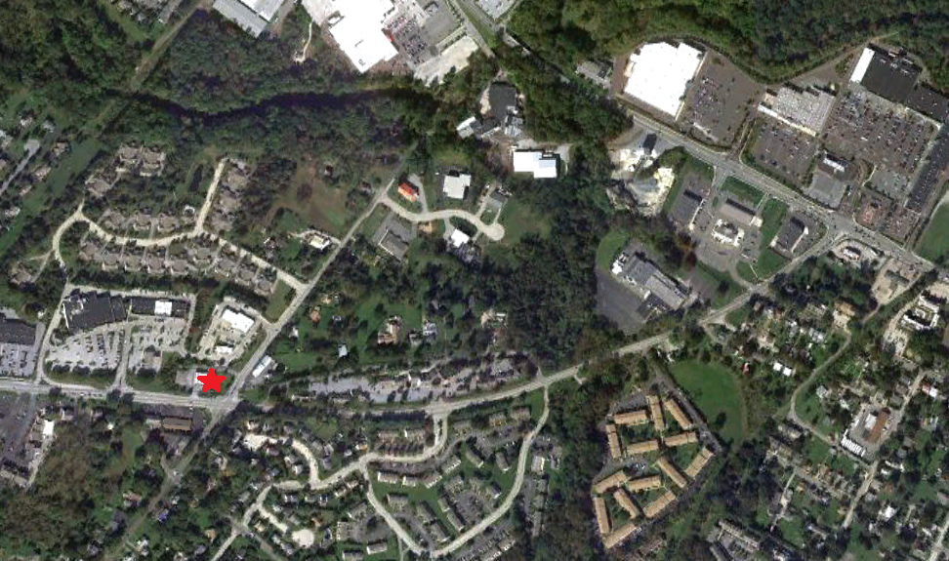

500 Kimberton Road
Phoenixville, PA 19460
RETAIL PROPERTY
FOR LEASE
U N I T E D I N V E S T M E N T P R O P E R T I E S
P. O. Box 2289 Telephone: (610) 594-7770
West Chester, PA 19380 Fax: (610) 594-7771 www.uiponline.net e-mail: uip@uiponline.net

Slide 2
500 Kimberton Road
Phoenixville, PA 19460
Property Description
Location: 500 Kimberton Road
Corner of Kimberton Road (Route 113) and Township Line Rd.
Phoenixville, Pennsylvania
Lot: 1.40 +/- Acres
Building Size: 3,055 square feet of existing building
Frontage: 275 feet frontage on Kimberton Road (Route 113)
180 feet frontage on Township Line Road
Street Improvements: Asphalt, paved roadways and concrete curbing
Utilities: On-site public water and sewer
Access: Access to the site is provided via Kimberton Road, Township Line Road and via the adjoining shopping center.
Parking: 60 parking spaces approximately
Zoning: “C” (Commercial)
Offer: This property is being offered for lease or ground lease.
U N I T E D I N V E S T M E N T P R O P E R T I E S
P. O. Box 2289 Telephone: (610) 594-7770
West Chester, PA 19380 Fax: (610) 594-7771
www.uiponline.net e-mail: uip@uiponline.net
p. 2

Slide 3
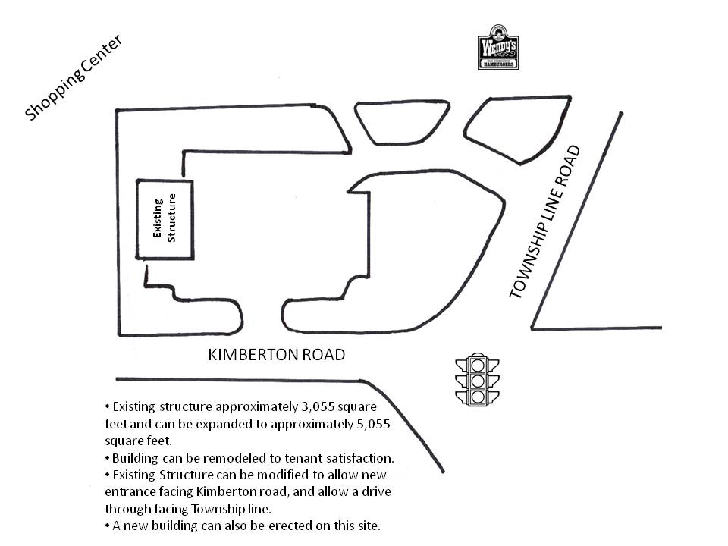
500 Kimberton Road
Phoenixville, PA 19460
Property Layout:
U N I T E D I N V E S T M E N T P R O P E R T I E S
P. O. Box 2289 Telephone: (610) 594-7770
West Chester, PA 19380 Fax: (610) 594-7771
www.uiponline.net e-mail: uip@uiponline.net
p. 3

Slide 4
500 Kimberton Road
Phoenixville, PA 19460
Market Overview
This site is situated in the heart of Phoenixville with a booming residential population of almost 75,000 people within a five mile radius, and has an estimated average household income greater than $107,000. Less than two miles away, is Phoenixville Hospital. The hospital is undergoing a $90 million expansion which will make it a major medical hub for the region.
Phoenixville, a borough in Chester County, is located approximately 28 miles northwest of Philadelphia. Chester County is the highest-income county measured per capita and by median household income in Pennsylvania, and 24th highest in the nation as measured by median household income.
Local Merchants
This site benefits from being in the center of many national businesses, and shopping centers in the immediate area, as well as numerous national restaurants and retailers. Some of these include Wendy’s, Subway, Dairy Queen, McDonalds, KFC, Taco Bell, Wawa, Boston Market, CVS, Rite Aid, Phoenixville Hospital, Staples, Sears hardware, Sherwin-Williams, Dollar Tree, Citizens Bank, Customers Bank, Wells Fargo, Phoenixville Federal Credit Union, Verizon Wireless, Radio Shack, Advanced Auto Parts, STS Tire, Big K Mart, and Giant Market.
U N I T E D I N V E S T M E N T P R O P E R T I E S
P. O. Box 2289 Telephone: (610) 594-7770
West Chester, PA 19380 Fax: (610) 594-7771
www.uiponline.net e-mail: uip@uiponline.net
p. 4

Slide 5
500 Kimberton Road
Phoenixville, PA 19460
U N I T E D I N V E S T M E N T P R O P E R T I E S
P. O. Box 2289 Telephone: (610) 594-7770
West Chester, PA 19380 Fax: (610) 594-7771
www.uiponline.net e-mail: uip@uiponline.net
p. 5

Slide 6
500 Kimberton Road
Phoenixville, PA 19460
p. 6

Slide 7
500 Kimberton Road
Phoenixville, PA 19460
p. 7

Slide 8
500 Kimberton Road
Phoenixville, PA 19460
p. 8

Slide 9
500 Kimberton Road
Phoenixville, PA 19460
p. 9

Slide 10
500 Kimberton Road
Phoenixville, PA 19460
p. 10

